Slide 1



Name of Project :
WATER QUALITY PREDICTION
NAME: SNEHA PRACHI BECK
STUDENT_ID: STU6720972d8b4dc1730189101

Slide 2

Learning Objectives
GOAL OF THE PROJECT:
To develop a machine learning based system that can predict the quality of water using the historical water quality data and algorithms. This model helps to classify the Water Quality Index(WQI), depending on the level of pollutants present. This project contributes to public health and environmental sustainability to monitor water pollution levels.
GOAL

Slide 3
Learning Objectives
Understanding the data and identifying key water pollutants and their environmental significance.
Processing and analyzing the dataset using techniques like data cleaning.
Using machine learning to predict or classify water quality based on historical dataset.
Designing a model that takes input to produce a meaningful predictions.
Deploying a web-based application for real-time, user-friendly water quality predictions.

Slide 4
Tools and Technology used
The tools and technologies used here are:
Python 3.12
Pandas, NumPy – Data handling
Scikit-learn – Machine learning model and evaluation
Matplotlib, Seaborn – Data visualization
Jupyter Notebook – Interactive experimentation
Streamlit – Web Deployment
Pickle/Joblib Files(.pkl) - Model and File Management
GitHub

Slide 5
Methodology
1.Data Collection:
We began by using a historical water quality dataset that includes various pollutants records at different stations over the years.
2. Data Preprocessing:
The missing and null values of the dataset were handled. Also add some features such as year and station ID. The categorial variables were converted into numerical format using one-hot encoding.
3. Model Development:
Train machine learning models such as Random Forest and Logistic Regression to predict six major water pollutants such as O2, NO3, NO2, SO4, PO4 and Cl.
4. Evaluation and Optimization:
Evaluate performance using metrices like accuracy, F1-score, or RMSE. The model was tested for accuracy and adjusted to ensure predictions are reliable.
5. Deployment using Streamlit:
Building a user-friendly web app using Streamlit where users input parameters and receive real-time predictions from the trained model.

Slide 6
Problem Statement:
Water pollution poses a significant risk to human as well as aquatic life. There is a growing need for a faster, cost effective, and scalable solution to predict water quality based on measurable environmental phases. We need to develop a machine learning-based predictive model that can automatically analyze the pollutants to determine the Water Quality Index (WQI) or classify the water as Safe or Unsafe for consumption or ecological use.

Slide 7
Solution:
To show the challenges of increasing water pollutants at scale, we have developed a machine learning-based system that can automatically predict the quality of water by predicting the concentration of six key water pollutants using two inputs year and station ID. A Random Forest Classifier model was trained on historical water quality data which is capable to generate accurate and location specific outputs.
For accessibility, we built a user-friendly web application using Streamlit, allowing users to input water samples and receive instant predictions. With just providing the year and station ID environmental officers can estimate pollutant levels for any monitored site.
This project offers a faster, cost-effective, and scalable alternative to manual water testing, supporting timely environmental monitoring and public health decision making. This predictive approach will help in protecting the water resources in India.

Slide 8
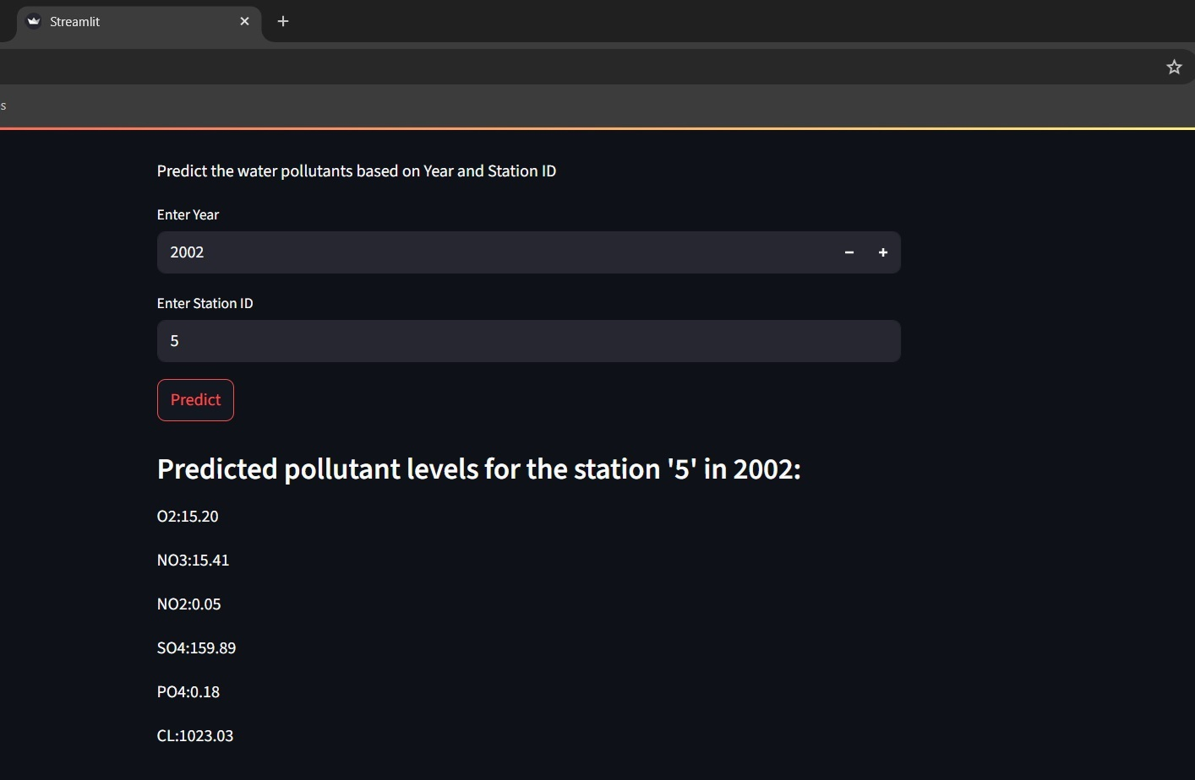
Screenshot of Output:

Slide 9
Conclusion:
This project demonstrated the application of machine learning to predict the water quality based on important physicochemical parameters which address the environmental problems . By training the model in historical water quality data it accurately predicted the water quality classifying the six major water pollutants. It was aimed to reduce the heavy reliance on manual water testing. By putting just two inputs "year" and "station ID" our model is able to estimate the concentration of six major pollutants. The clean and user friendly interface with the help of Streamlit made it more interactive, accessible, and easy to use for the real time predictions. In general the project highlights the potentional of this project in environmental monitoring, offering a scalable, cost-effective and efficient alternate to the traditional water testing methods. Also it helps to easily monitor the water quality for the future use. It contributes to sustainable waste management.
To conclude this project is a step towards better water management and contributes to the environmental sustainability. With future development, it has potential to reach across different regions to resolve the issue of collection of water quality data and also can contribute to clean water initiatives.

Slide 10
Model Performance and Project Resource :
The model demonstrated strong and reliable performance in predicting the water quality. It achieved accuracy with a balanced precision indicating its effectiveness in correctly classifying the water pollutants. The cross-validation further validated the model's stability.
Resources:
All the resources and code for this project is present in the below github link, which also includes the deployment part of the project under name of app.py.
pollution_model.pkl: https://drive.google.com/file/d/18RJzu35vyuMgpcAE590u1IaDvHY3-SWq/view?usp=sharing
GitHub Repository:
Click here to check my GitHub Repository
Thank You for taking time to see my project. I truly am grateful to work in this project and would like to contribute more in the field of AI and ML.

